Slide 1
WHAT HAS HAPPENED?
PRESENT PERFECT SIMPLE
A past action that has an influence on the present

Slide 2
PART 1

Slide 3
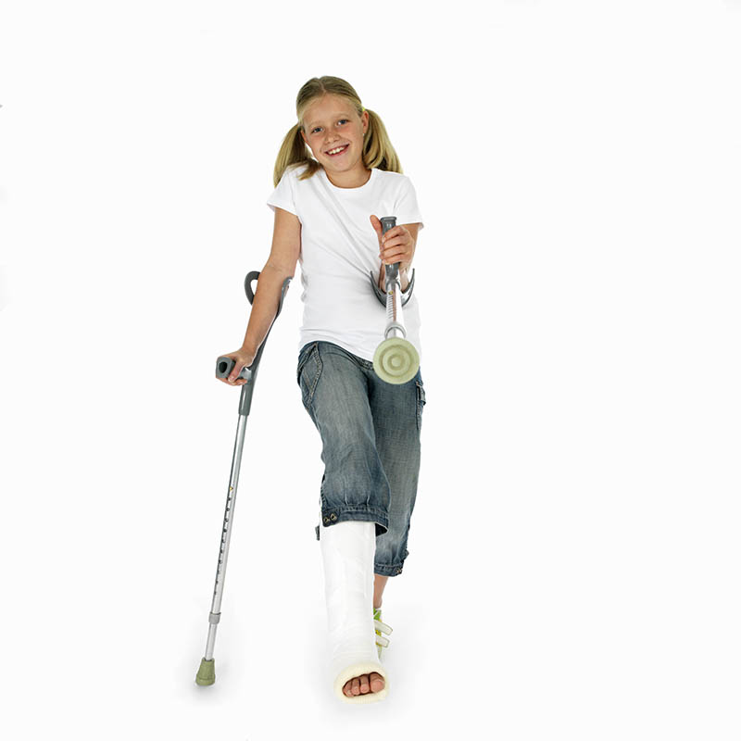
Linda cannot walk to school today.
BREAK
She _____________ her leg.
has broken

Slide 4
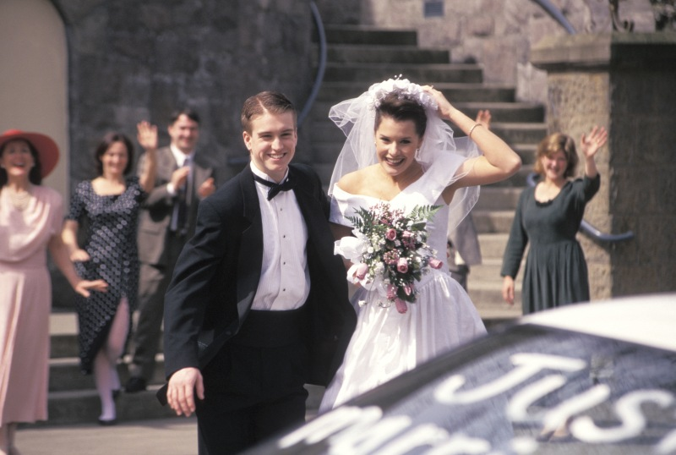
Greg and Sue look very happy at the moment.
GET
They _______ just _______ married.
have
got

Slide 5
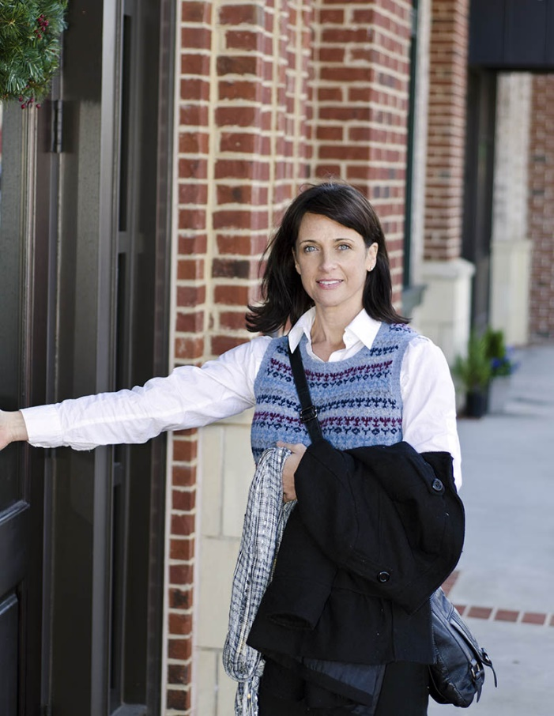
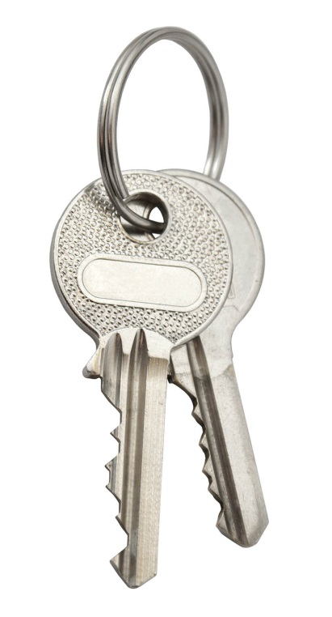
Look! Sarah can’t get into her house.
LOSE
She___________ her key.
has lost

Slide 6
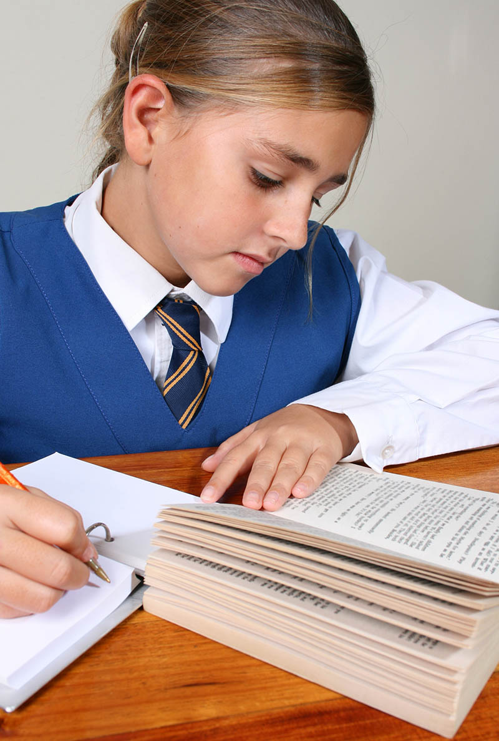
I think I’ll get an F.
NOT STUDY
I __________________ hard.
haven’t studied

Slide 7

My sisters are not at home at the moment.
GO
They ____________ to the shopping mall.
have gone

Slide 8
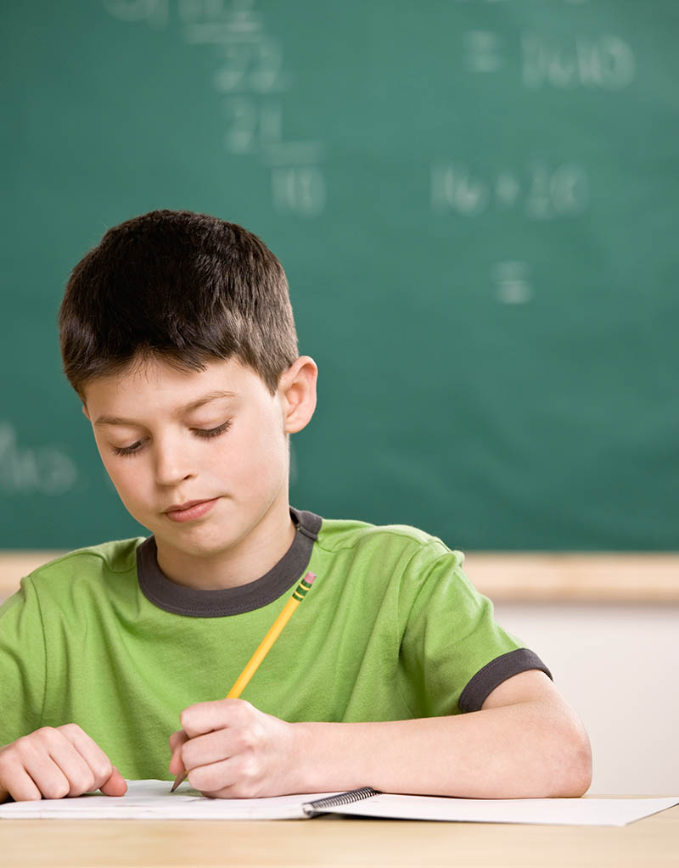
Bobby can’t go to the playground now.
NOT DO
He ______________ his homework.
hasn’t done

Slide 9
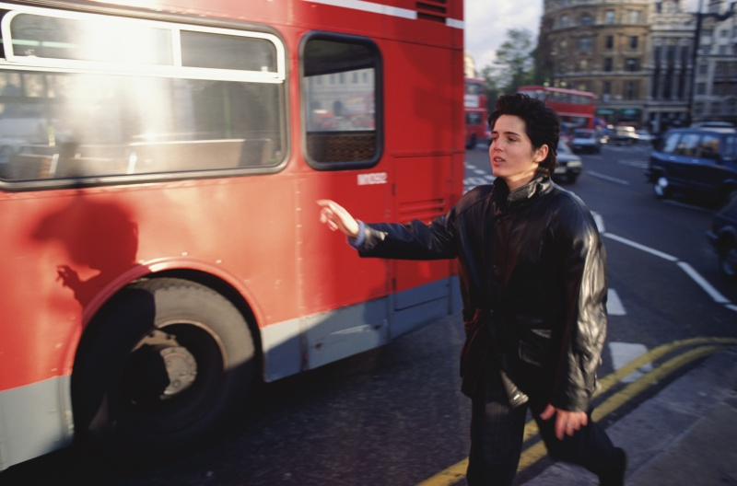
I’ll be late for school again.
MISS
I _______________ the bus.
have missed

Slide 10
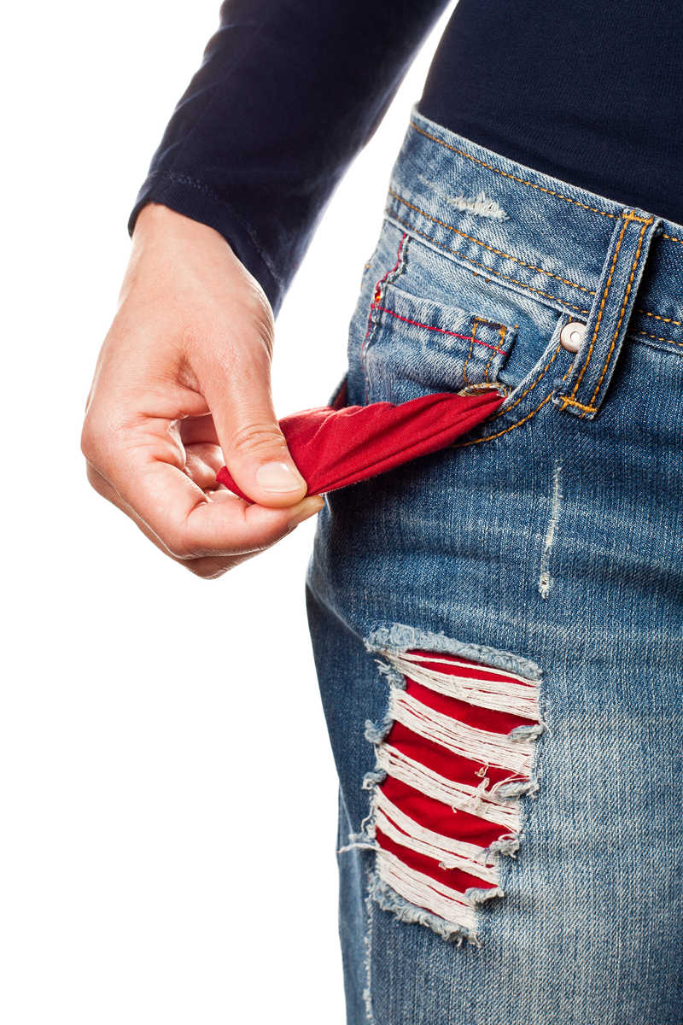
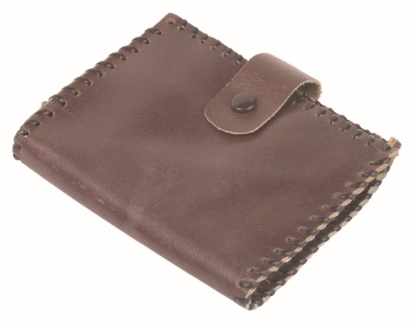
Can you lend me some money?
LOSE
No, I can’t.
I ____________my wallet.
have lost

Slide 11
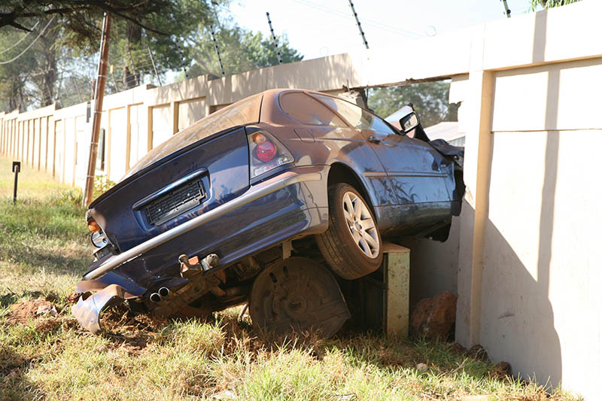
John is not at work today.
He is at hospital.
HAVE
He ___________ a car accident.
has had

Slide 12
PART 2

Slide 13
My finger is bleeding.
What has happened to me?
Can you guess?
You have cut yourself.

Slide 14
Alan looks so miserable.
What has happened to him?
Can you guess?
His girlfriend has left him.

Slide 15
Bill is in prison now.
What has happened?
Can you guess?
He has robbed a bank.

Slide 16
My children are not hungry at the moment.
Why?
Can you guess?
They have just had dinner.

Slide 17
Mary has a stomachache.
Why?
Can you guess?
She has eaten too much chocolate.

Slide 18
My brother is in the street.
He is crying.
What has happened to him?
Can you guess?
He has fallen off his bike.

